Slide 1
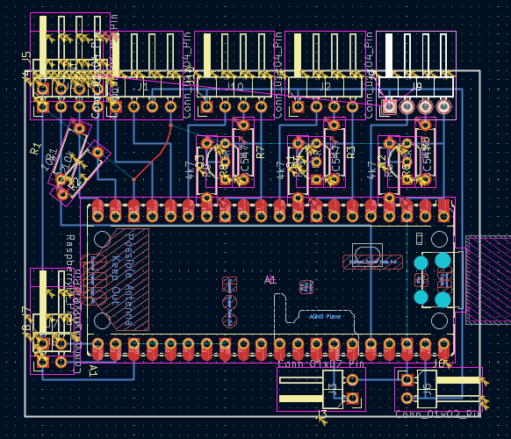
Displays
Trellis
BTN2
BTN3
BTN1
GND
3V3
SCL
SDA
SCL
SDA
5V
GND
5V
SW
LED
GND
5V
SW
LED
GND
5V
SW
LED
GND
GND
MODEL_1
GND
MODEL_3
GND
GND
PROB_SW
5V
5V

